Slide 1

Wiliam Roberts CIS126 Prof. Stephen Leggett
Task 6

Slide 2

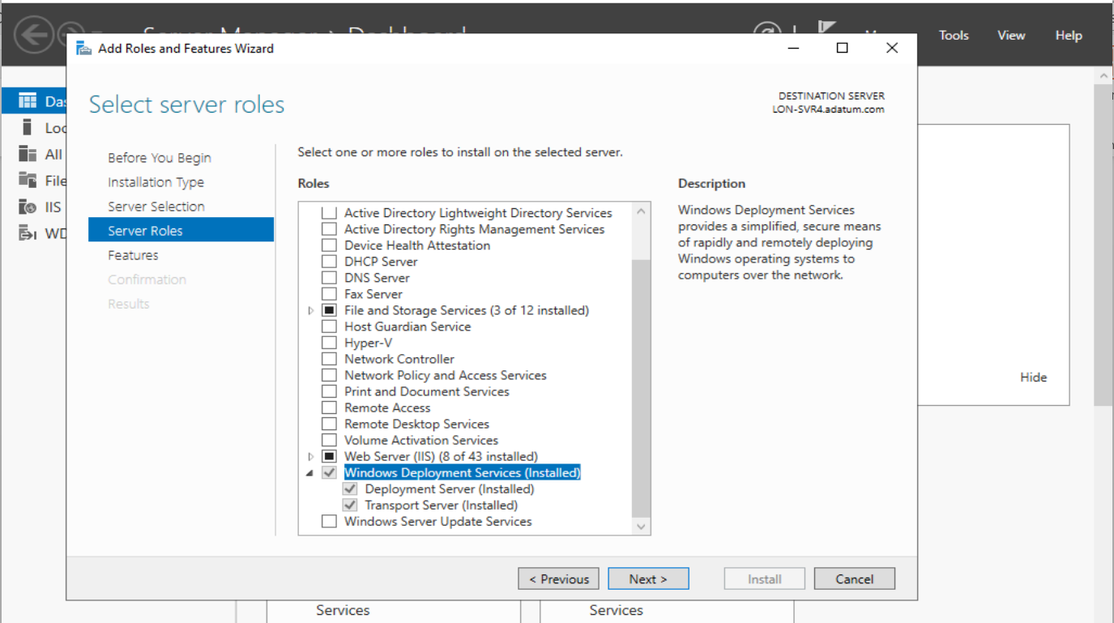
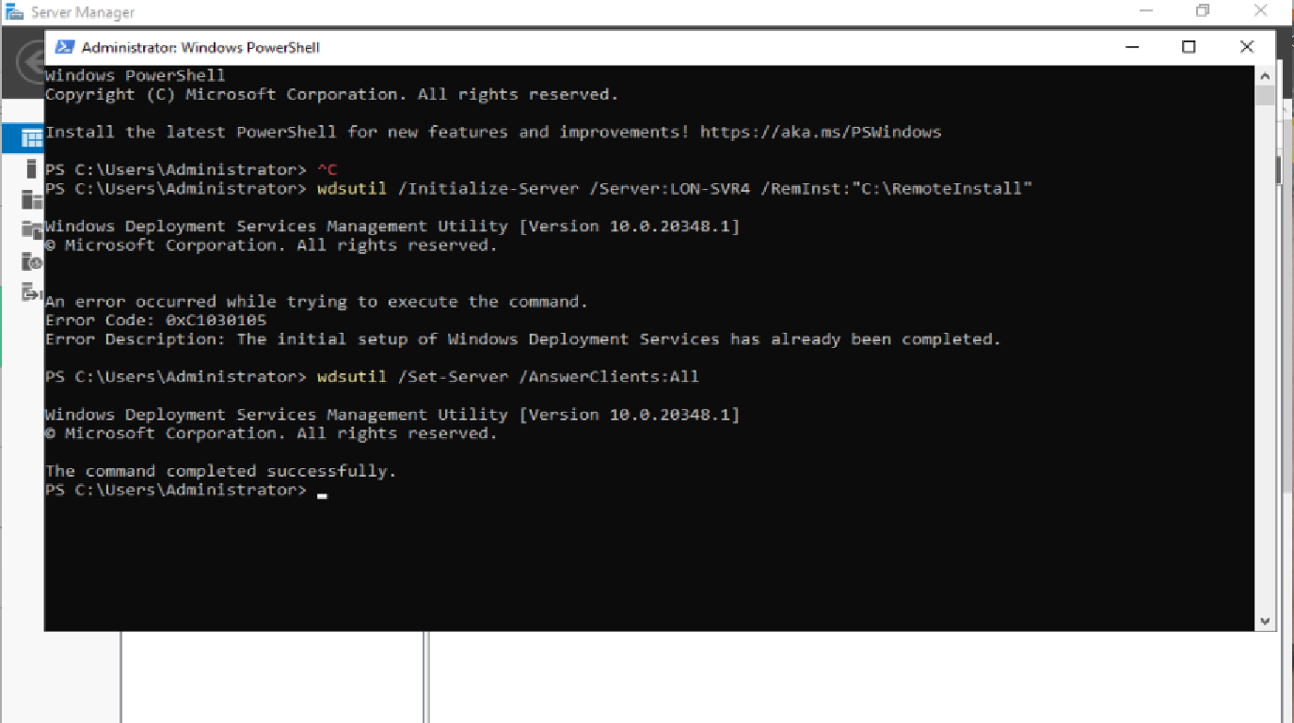

Install & Configure Windows Deployment Services on Lon-SVR4

Slide 3
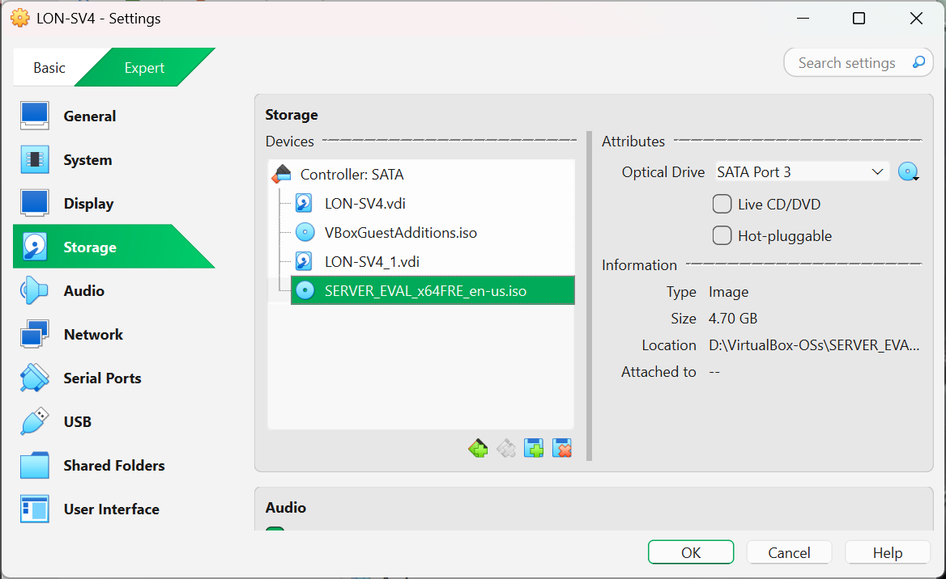
Add drive with ISO image LON-SRV4

Slide 4
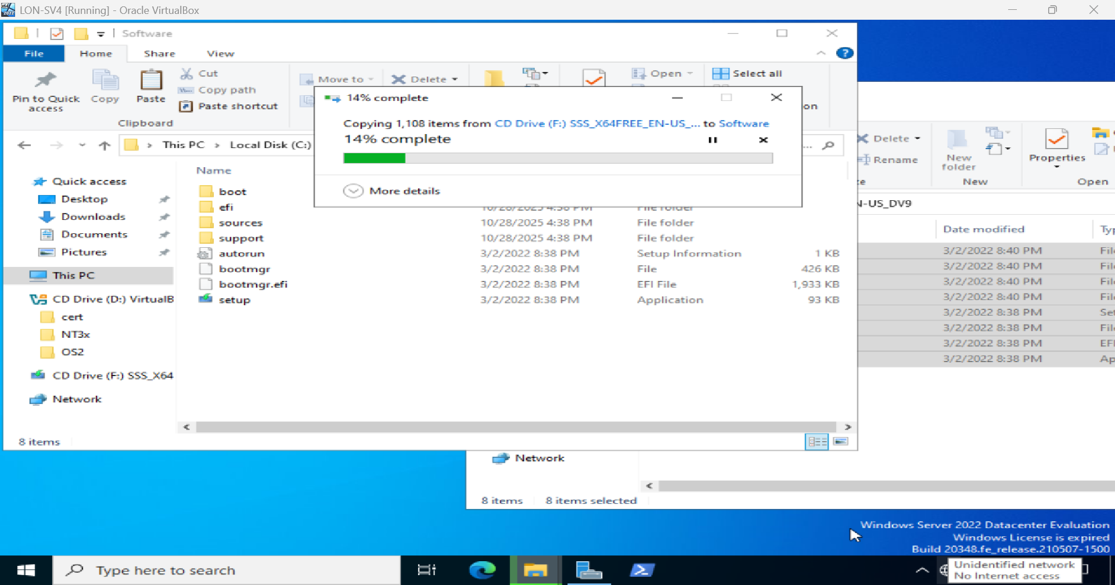
Copy ISO file to c drive LON-SRV4

Slide 5
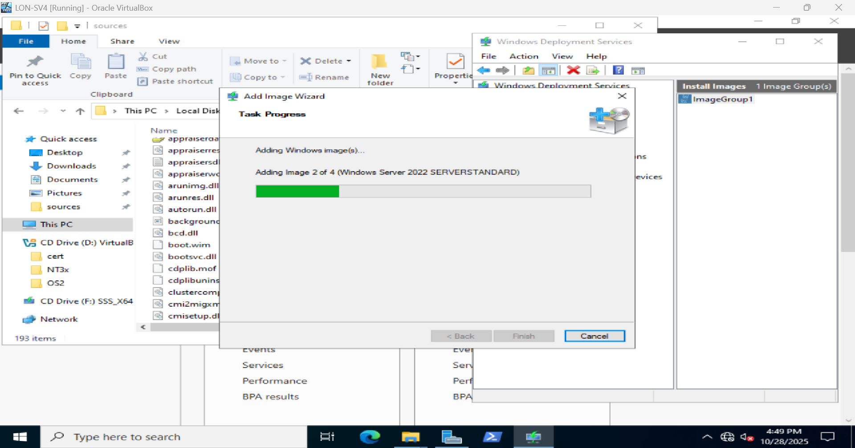
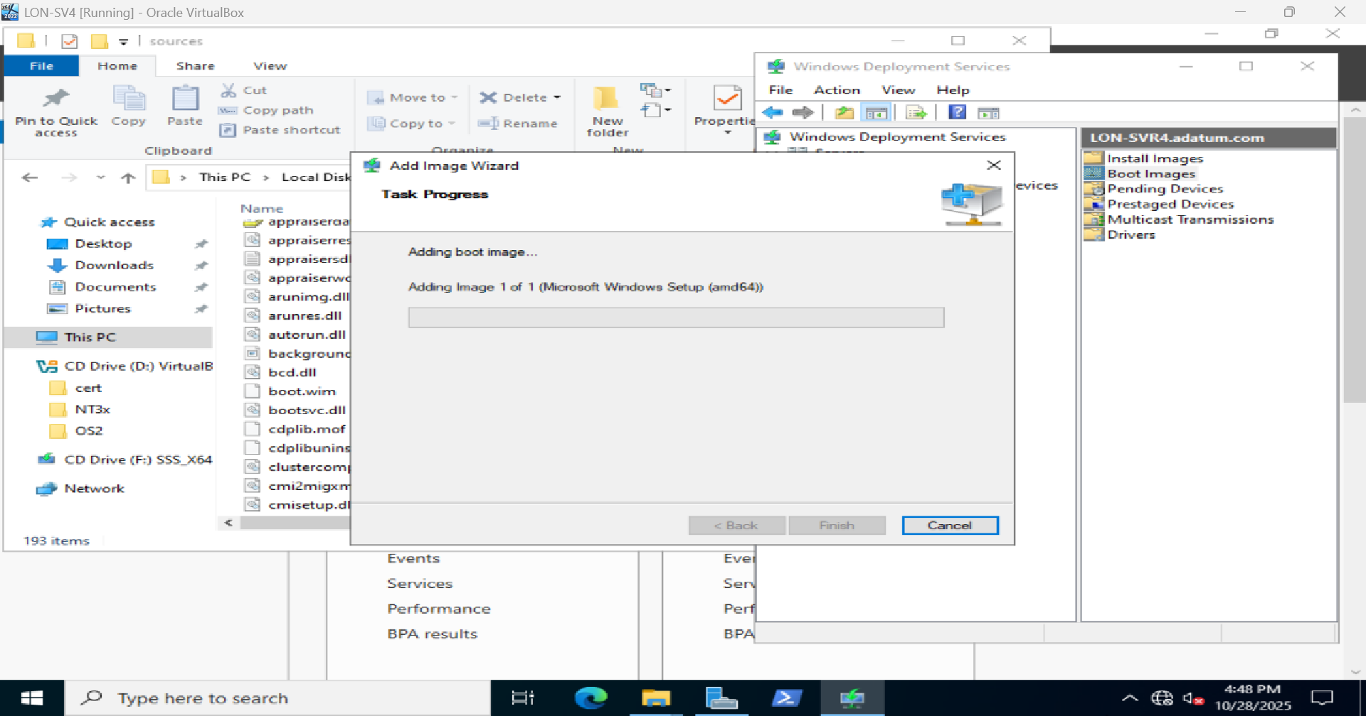
Add boot and install image LON-SRV4

Slide 6
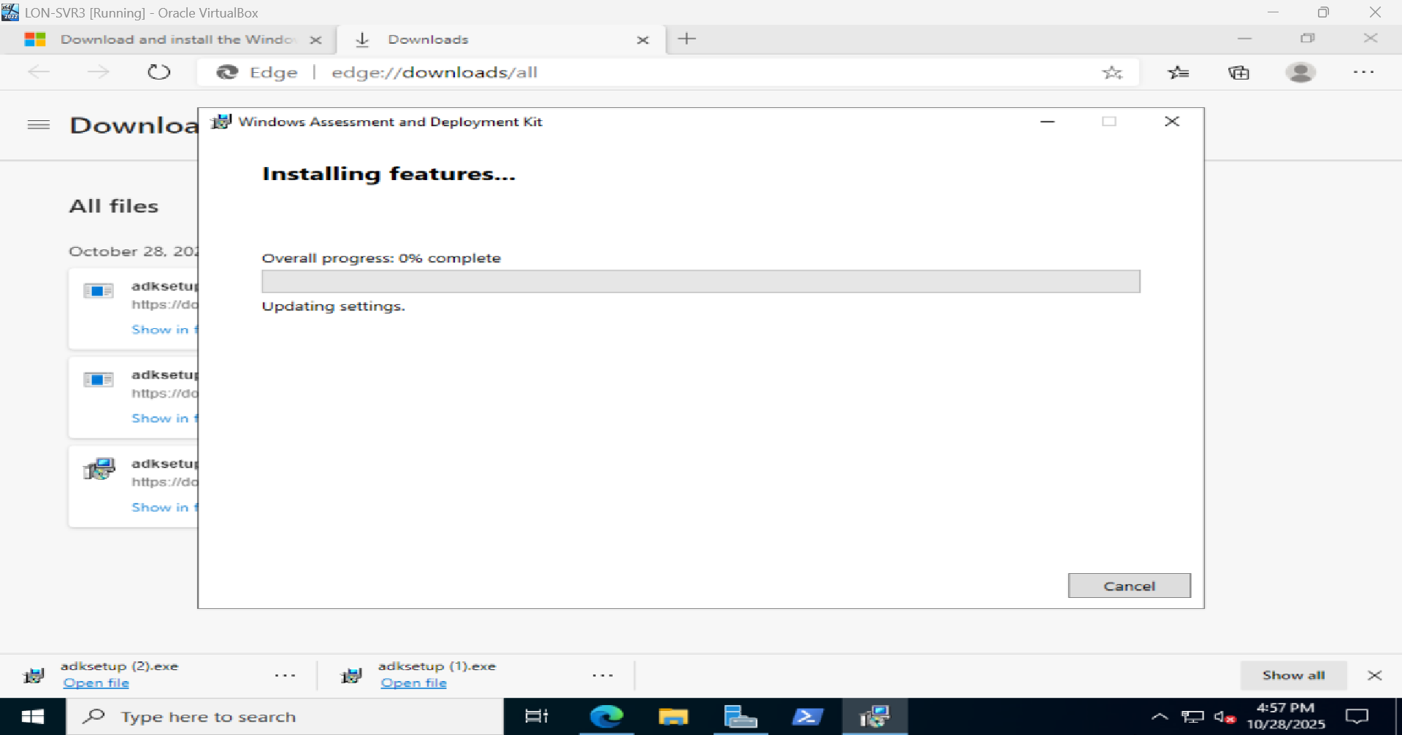
Install Windows ADK LON-SRV3

Slide 7
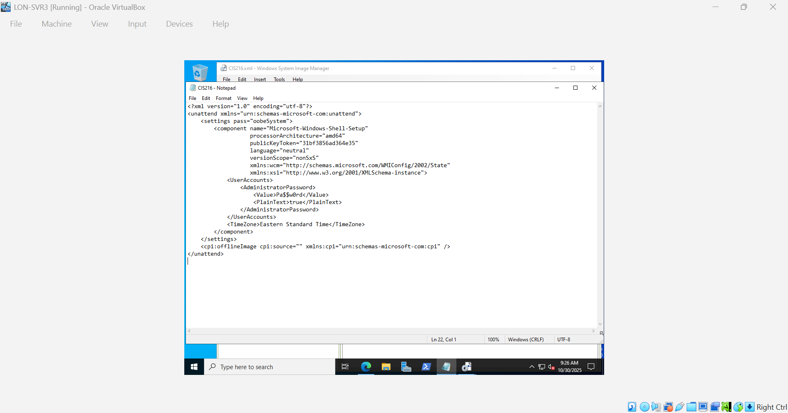
Add XML block

Slide 8
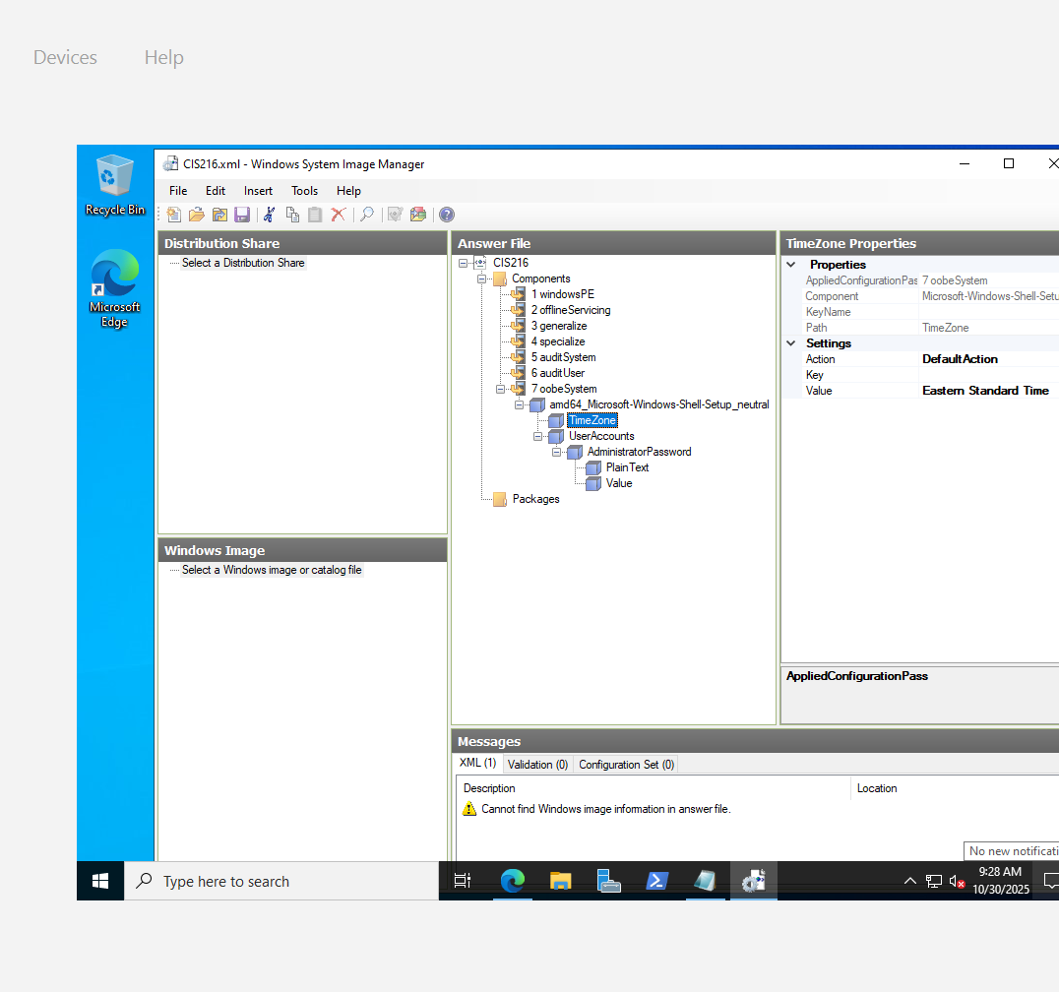
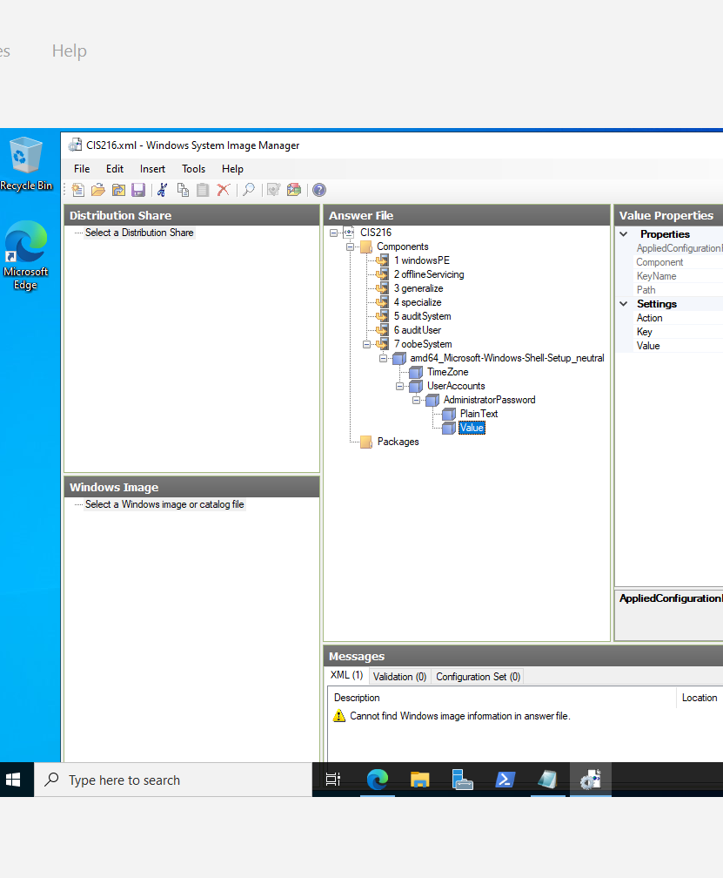
Verify time zone and password LON-SVR3

